Slide 1
What’s In a Number?
Applying Beneford’s Law to Stock Market Prices

Slide 2
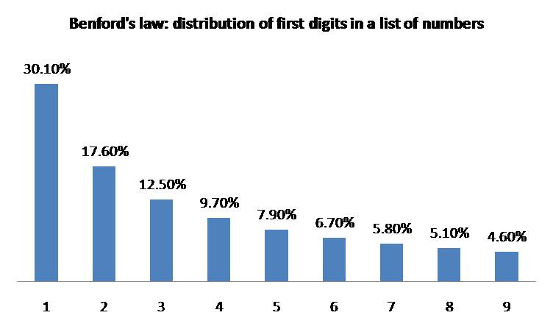

What is Benford’s Law?
The First Digit Law
Discovered by Simon Newcomb in 1881
Based of the logarithmic distances between numbers
$P\left(d\right)=log10\left(d+1\right)−log10 (d)$
Can be applied to any set of natural appearing numbers that have no cutoff ( ie number of people on a plane) and span multiple magnitudes of 10 (ie 1-1000 not 1-10)

Slide 3
Applications of benford’s law
Can be used in any US court to prove tampering with financial data
Has been shown that one day returns of both the S&P 500 and the Dow Jones industrial Average agree with Benford’s Law
Population totals, length of rivers, the Fibonacci sequence, election data, space used on a computer hard drive etc.

Slide 4
Question To Be Answered?
Do the leading digits of the stocks in the US stock market conform to Benford’s Law?
Given that stocks in the US markets conform to Benford’s Law, can that information be used to achieve unusual returns?

Slide 5
Answering Question 1
The whole US Stock market is too big and too difficult a population size to measure ( US Stock Market is a vague term, How does one get hold of a sampling frame?)
Solution: Limit the sampling frame to the prices of one index (DJ, S&P 500, etc.)
Which index? Started with S&P 500. Companies were too similar and prices did not have the range needed
Decided to focus on the Russell 2000

Slide 6
Russell 2000
Small Cap Companies ( 3 billion to 129 million)
More Price Variation ( good for both quicker changing first digits and greater range to stock prices)
Four Samples were taken on August 27, 28,29, and September 2
Samples conformed better and better to Benford’s Law as sample sizes increased

Slide 7
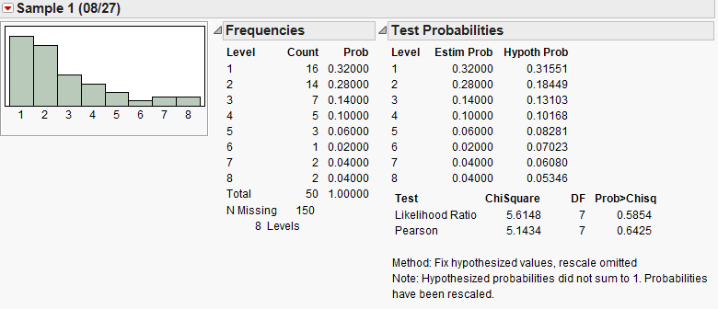
Distribution's of Samples Taken

Slide 8
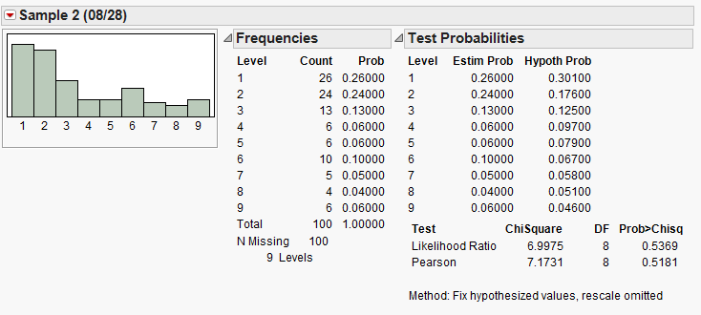
Distribution's of the Samples Taken

Slide 9
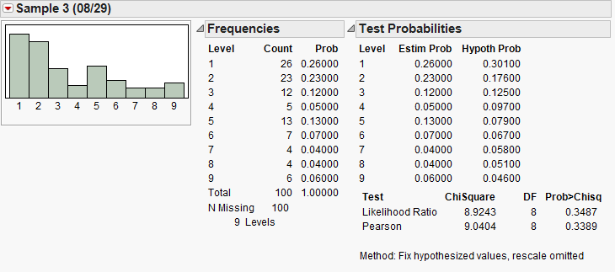
Distribution's of the Samples Taken

Slide 10
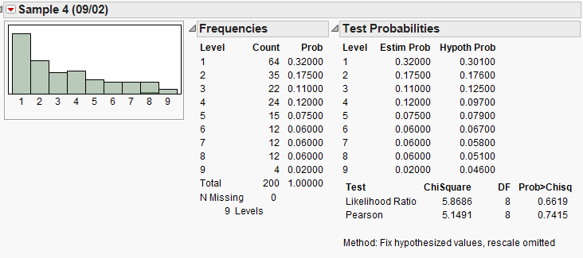
Distributions of the Samples Taken

Slide 11
Question 1 slightly Changed and Slightly Answered
New Question 1 : Do the leading digits of Small Cap US stocks (represented by the Russell 2000) conform to Bedford's Law?
Answer: Yes, distributions of leading digits from increasingly larger samples of the Russell 2000 fit Benford’s distribution with increasing accuracy
Now on to Question 2 : What can be done with this new information?

Slide 12
Answering question 2
How can unusual returns be made given the knowledge that Small Cap US stocks follow Benford’s Law?
What do we know
Returns are made by buying low and selling high
Stock prices are dynamic and will change over time
Each leading digit has 3 options : Go up, Go down, or Stay the Same
At each point in time, the distribution of US Small Cap Stock Leading Digits should conform to Benfords Law

Slide 13
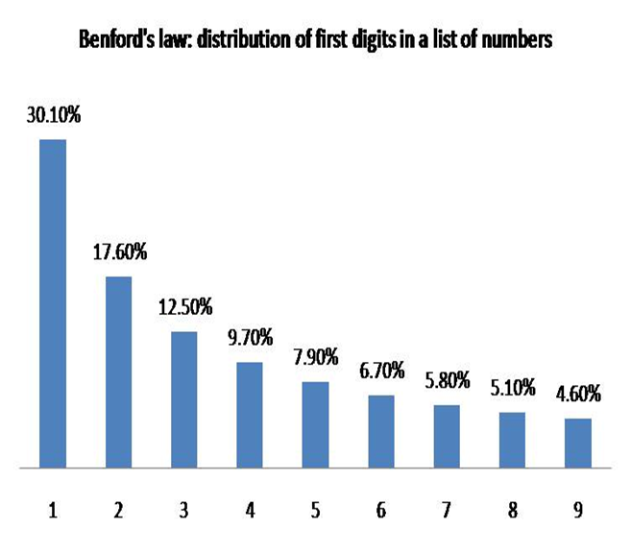

Answering Question 2
Consider Benford’s Law Distribution
Now if a Stock has a leading digit 1, it can turn into a 2, regress back into a 9, or stay a 1.
What is the Probability of any stock having a leading digit 1,2, or 9?
$0.301+0.176+0.046=0.523$
So the Chance of a 1 remaining a 1 would be $\frac{0.301}{0.523}=0.5755$

Slide 14
Answering Question 2
Leading Digit | Up | Stay | Down
1 | 0.3365 | 0.5755 | 0.0879
2 | 0.2076 | 0.2924 | 0.5000
3 | 0.2437 | 0.3141 | 0.4422
4 | 0.2625 | 0.3223 | 0.4153
5 | 0.2757 | 0.3251 | 0.3992
6 | 0.2843 | 0.3284 | 0.3873
7 | 0.2898 | 0.3295 | 0.3807
8 | 0.2968 | 0.3290 | 0.3742
9 | 0.7563 | 0.1156 | 0.1281

Slide 15
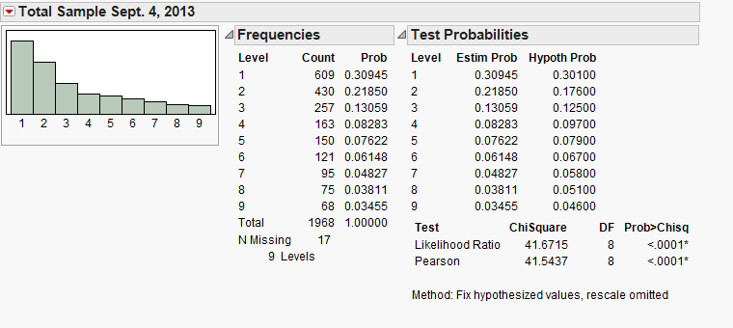
THe Next Step
A sample of the entire Russell 2000 was taken on September 4, 2013

Slide 16
Two Approaches
Markov Chains
Following the 9’s

Slide 17
Markov CHains
A Stochastic Process
The probability of any particular future behavior, when the current state of the process is known, is not altered by additional knowledge concerning its past behavior (Pinsky and Karlin 2011)
Each leading digit is a state
The only knowledge that matters to predict a future state (the next leading digit) is knowledge of the current state (the current leading digit).
Create discreet time Markov chains and Markov Matrixes at 5, 15, and 30
See how leading digits change over time and how long it takes 9 to change into 1s

